Slide 1
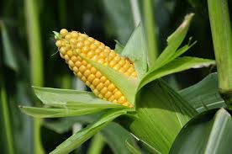
Cultivation Practices of Maize
Prepared By:
Harichandra Singh (B.Sc.Ag)

Slide 2
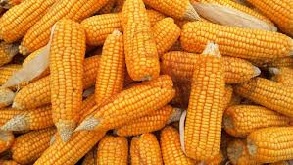
Maize
S.N: Zea mays
Family: Gramineae or Poaceae
Origin: Central America and Maxico
Importance:
It is used as human food and livestock feed.
It is used to prepare many food items and beverage called Jand and raksi.
It is also used to making plain bread (ideal food for diabetic person)
It contain about 70% carbohydrates, 10% crude protein, 38% oil etc.

Slide 3
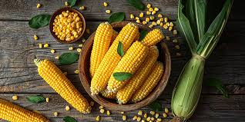
Distribution of Maize in Nepal:
It occupies second position after rice in Nepal.
It is cultivated from terai to high hills.
Highest production in Koshi province
Maximum Area covered by Koshi Province
Highest Productivity in Madhesh Province
Varieties:
For Terai Region: Arun-2 (Early 80-90 DAS), Rampur-2, Rampur-4
For Mid Hills: Manakamana-1, Mankamana-3
For High Hills: Ganesh-1, Ganesh-2
Highest Productivity: Rampur Hybrid 12, F1 (9.44Mt/ha)

Slide 4
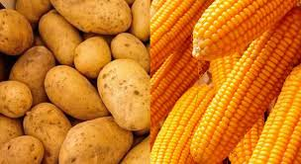
Temperature:
Ideal temperature for maize crop is 20-24 °C
Below 14°C and Above 47°C and low humidity have negative impacts on crops.
Cropping Pattern:
Maize-Wheat Terai/Hills
Maize-Mustard Terai/Hills
Maize-Potato Hills
Maize + beans – Barley Hills

Slide 5
Field Preparation:
Maize crop needs a well aerated, moist and weed free field.
First Ploughing is done for loosening 20-25 cm deep soil.
2-3 harrowing if followed and proper leveled field is required.
Manure & Fertilizer:
It required 10-20 tons of well-decomposed OM (2-3 week before sowing)
Recommended dose of NPK
The dose of NPK and other fertilizer is required based on nutrient status of the soil. So, we should apply the fertilizer after soil testing. In General we followed following dose;
For open pollinated variety 120:60:40
For hybrid variety 150:60:60

Slide 6
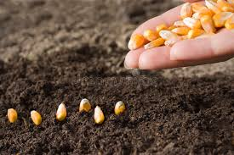
Seed & Sowing:
Seed rate for maize crop is 18-20 Kg/ha
Certified seeds of improved varieties should be selected for higher yield.
Appropriate plant spacing is 60 cm R*R & 20-25 Cm P*P.
Time of Planting Asar to Saun ( June-July)
Seed treatment by fungicide like bevistin.
Water Management:
Provide proper drainage facility.
During Emergence
Vegetative growth
Tasseling & Silking (Most Critical Stage)

Slide 7
Intercultural Operation:
One or two intercultural operation are required i.e during vegetative stage and at second intercultural operation earthing up is done.
Removal of weed during intercultural operation.
Harvesting, Threshing and Storage:
Maize crop is ready to harvest when the husk turn yellow and the kernels are hard enough having less than 30% of moisture.
After harvest of cobs are dried in sunlight with or without removing the husk.
The kernels are removed either by beating the cobs by sticks or with the help of maize shelters.
After completely dried stored in containers or other suitable materials.
For seed purpose, maize cobs are dried and stored in open shed without removing husk.

Slide 8
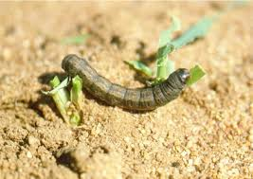
Yield:
It depend on different factors like varieties, nutrient status etc.
In General, 3-4 ton/ha can be produced.
Insect/Pest of Maize:
Cut Worms (Agrotis segetum)
Symptoms:
It cut seedling of maize just above ground level.
It feeds during night time.
Management:
Crop should be grown in pest free field
Use of light trap
Imidacloprid

Slide 9
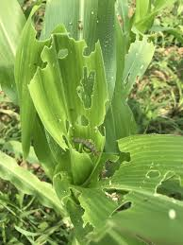
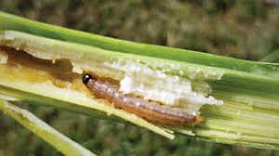
2. Maize Stem Borer (Chilo partellus):
Symptoms:
Larval stage damage crop by feeding on tender leaves making number of holes
Later they bore on the top internode and move downwards.
At severe stage “Dead Heart” symptoms occur.
Management :
Crop rotation should be followed
Hand picking and destroy of larva if possible
Destroy all the plants attack by the borer in severe case
Burn the stubbles immediately after harvest

Slide 10
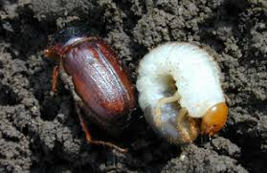
3. White Grub (Phyllophaga rugosa):
Symptoms:
Larva feed on roots of the plant.
Damage may result on complete failure of crops.
Management:
Deep ploughing of field after harvest
Grubs lay eggs in grasses and weeds. So, making field completely weed free in the month of Baishakh, Jestha before maize cultivation can reduce white grub attack.
Use of completely decomposed compost and FYM
Collect and destroy the white grub during tillage operations.
Apply chemicals like Thimet @ 15kg/ha.

Slide 11
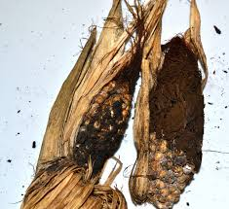
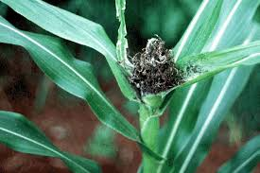
Maize Disease:
Head Smut (Sphacelotheca reiliana)
Symptoms:
Fungus produce powdery dirty mass covers the tassel, producing galls on the tassel of the plant.
Management:
Grow disease resistance varieties
Soil solarization should be done before sowing because this pathogen lives in the soil.
Seed treatment with fungicides (Thiram, Bavistin 2-3 gm/kg seeds.

Slide 12
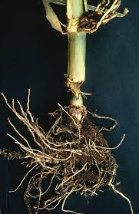
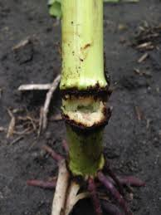
2. Pythium Stalk Rot (Diplodia zea)
Symptom:
Infected plant becomes short at lower internode get twisted and lodge over ground.
It become serious when plant is higher and water accumulates in the field during knee height stage to flowering stage.
Management:
Selection of disease resistance variety
Maintaining proper spacing
Apply captan @ 1.5 gm/kg

Slide 13
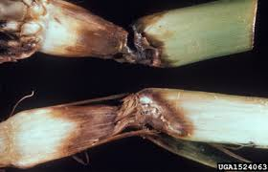
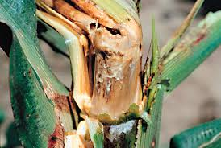
3. Bacterial Stalk Rot (Erwinia cartovora)
Symptom:
Basal internode becomes soft, discolored and gives a fermenting smells.
Management:
Avoid water logging at any stage of plant growth
Avoid injury on the plant at the time of hoeing, weeding & top dressing
Apply bleaching powder along rows 10-15 kg/ha

Slide 14
Thank You !

